Slide 1
Generative Adverserial Networks for Image Forgery
Vignesh M. Pagadala
Graduate Research Assistant
Database and Security Research Group
Department of Computer Science
Colorado State University
June 30, 2020

Slide 2
Presentation Overview
Expected duration ~ 1 hour
GAN: Introduction
Applications
Why we need GANs?
Discriminative vs Generative models
GAN: Details and Architecture
Hands-on: Example 1
DC-GAN
Hands-on: Example 2
Possible Research Potential

Slide 3
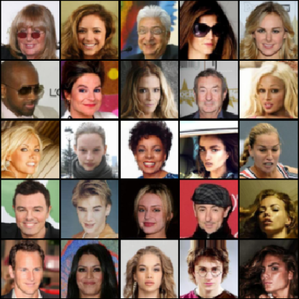
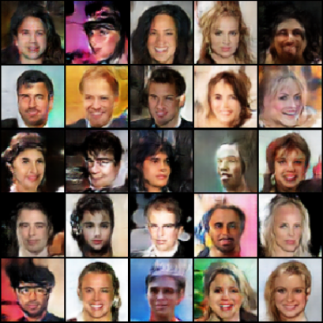
Generative Adverserial Networks: Introduction
A deep-learning methodology that can effectively capture the distribution in a given dataset, formulate a model out of the same, and use this model to generate new, realistic data from the same distribution.
A well-trained GAN, can model new data distributions from sample data such that the generated data is very similar to the original, or ideally, indistinguishable.
Uses two seperate networks - the Generator (G) and the Discriminator (D).
The Generator creates ‘fake’ data, and tries to make it appear as real as possible, and feeds it into the Discriminator.
The Discriminator looks at the spawned images from the Generator, and tries to determine whether it is a real or a fake image.
Original
Forged
source: https://pytorch.org/tutorials/beginner/dcgan_faces_tutorial.html
https://thispersondoesnotexist.com/

Slide 4
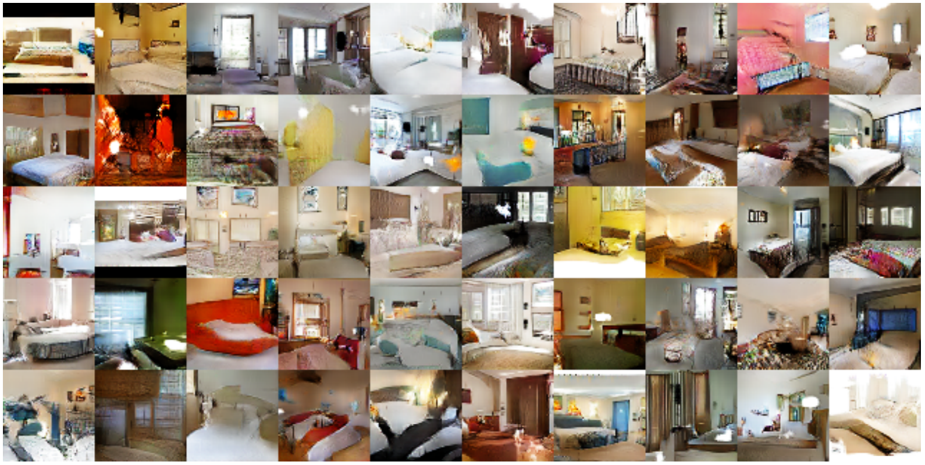
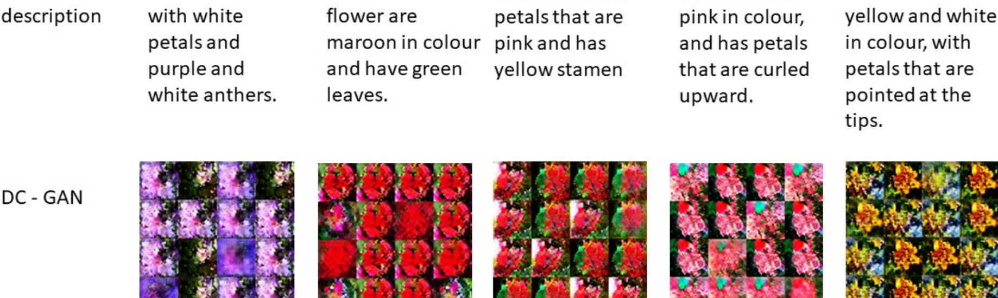
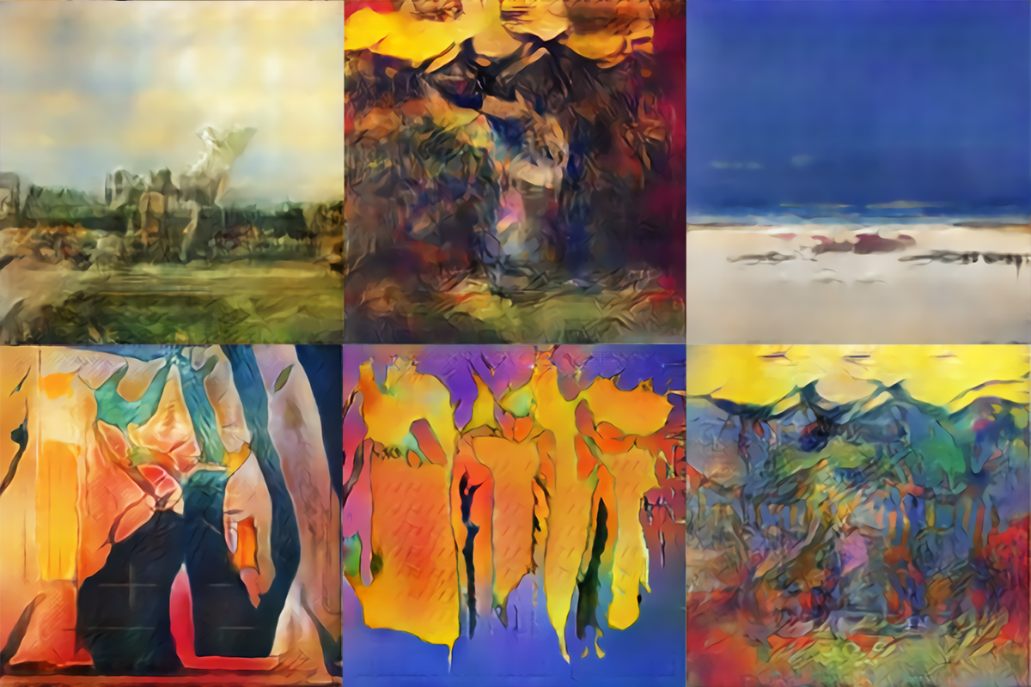
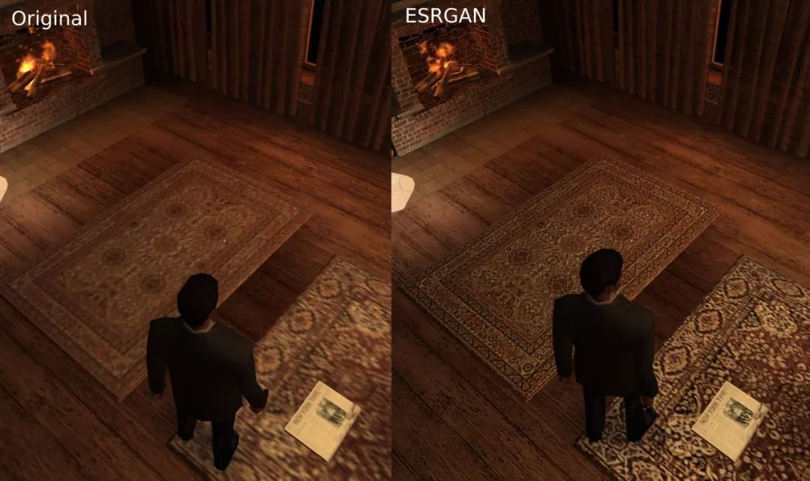
Applications
Fake image generation
Text-to-image synthesis
Resolution-scaling for single images
Fake Bedroom Images
GAN Generated Artwork

Slide 5
Applications
Security applications - stegonography and image forensics (SSGAN).
Attention prediction
Fake audio and video synthesis
https://thispersondoesnotexist.com/

Slide 6
Motivation: Why do we need GANs?
As stated before, GANs are used to perform high dimensional modelling of complex datasets.
There are already several methodologies which accomplish the same.
Here, we examine the novelty introduced with GANs.
GANs are essentially generative opposed to discriminative.
Traditionally, these types of tasks were performed using discriminative models, as opposed to generative ones.
What are generative and discriminative models?
Generative Models:
Models the actual distribution of each class.
Examples:
Naive Bayes classifier
Bayesian networks
Markov random fields
Discriminative Models:
Models the decision boundary between classes.
Examples:
Support-Vector Machines
Logistic regression
Neural networks (conventional)
Nearest-neighbour

Slide 7
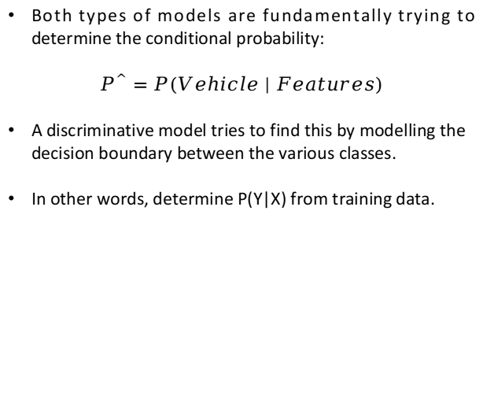
Discriminative Models
Consider two different networks A and B, which are each provided two images, a car and a truck. Their is objective is to correctly determine which type of vehicle a newly provided image would be.
Assume a new image of a car is provided to network A, with its task being to find out if it is a car or a truck. The network A does not know exactly what a car is, or what a truck is - it hasn’t captured the entire model.
However, it has captured the differences in the features of a car and a truck. Using this information, the network A finds the solution. This methodology is ‘discriminative’.
This is much easier to do than to try and capture the entire model.
Both types of models are fundamentally trying to determine the conditional probability:
$P^{^}=P(Vehicle | Features)$
A discriminative model tries to find this by modelling the decision boundary between the various classes.
In other words, determine P(Y|X) from training data.

Slide 8
Generative Models
Consider the same example which we saw before.
Consider the a new image of a car is provided to neural network B. B, unlike its counterpart, is able to compute the entire features which represents a ‘car’, because it has captured or modelled it fully.
Now, based on this known model, it compares to see if the new image is similar to the car it has modelled to find the solution. Neural network A is, therefore, generative.
Involves more effort than discriminative models.
This generative model is trying to find P(Y|X) by modelling the actual distribution of each class, as opposed to modelling just the class boundaries.
In other words, the generative models learns the joint probability distribution P(X,Y), and uses Bayes Theorem to find P(Y|X).
The value of P(Y|X) will possibly be different in both methods.

Slide 9
Discriminative vs Generative
Fundamentally, the differences between discriminative and generative models are:
Generative:
Pros: A nice, well-rounded model of the dataset is at our disposal. This can be used to generate other well-defined instances.
Cons: Not easy to model - involves high computations costs and in most cases, non-tractable.
Discriminative:
Pros: Easy to model. Can be modelled with limited number of data points in the training set.
Cons: The end result can be used as a suitable classifier, but cannot be used to generate synthetic samples. The full model of the distribution is not captured.
Therefore, in-spite of the advantages offered by generative models, their use in inhibited due to high, non-polynomial time complexities. What we need is a nice generative model that is tractable.

Slide 10
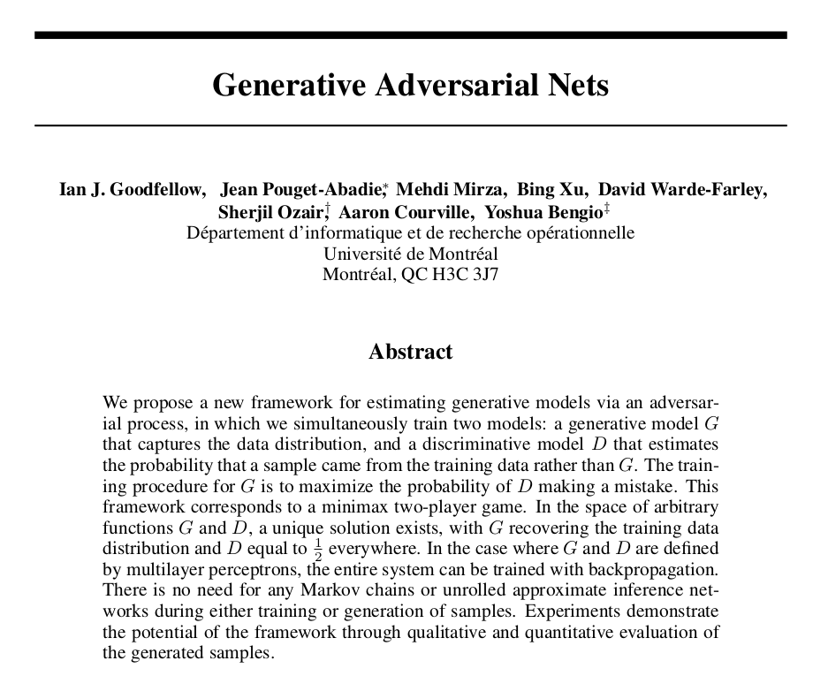
Generative Adverserial Networks
The novel methodology was first first defined by Goodfellow et al. in the paper “Generative Adverserial Nets” [Goodfellow, Ian, et al. "Generative adversarial nets." Advances in neural information processing systems. 2014.]
The paper has 20,232 citations to-date.
What problem does it solve exactly? Fundamentally, it tackles the same problem use-case of deep-learning in-general, which is to find rich, well-fitted models that effectively capture data distributions.
The novelty here lies in the fact that Goodfellow has achieved this using a generative, rather than a discriminative model, while still maintaining tractablility.
The paper demonstrates the viability of generative modelling.

Slide 11
Generative Adverserial Networks
A neural network that captures the training data’s distribution in order to generate new data from the same distribution.
Contains two seperate networks - the Generator (G) and the Discriminator (D).
The Generator creates ‘fake’ images, and tries to make it appear as real as possible, and feeds it into the Discriminator.
The Discriminator looks at the spawned images, and tries to determine whether it is a real or a fake image.
Both G and D are essentially involved in playing a min-max game, trying to minimize their respective loss functions.

Slide 12

GAN: Architecture
Source: pathmind.com/wiki/generative-adversarial-network-gan

Slide 13
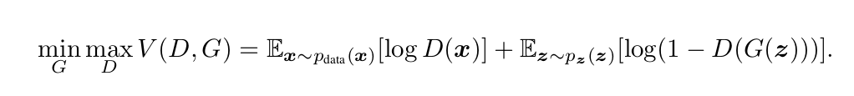
GAN: Methodology
Essentially, the system reaches “equilibrium”, when the generator spawns really convincing fake images, and the discriminator constants guesses correctly and incorrectly, so as to reach a probability of 1/2.

Slide 14
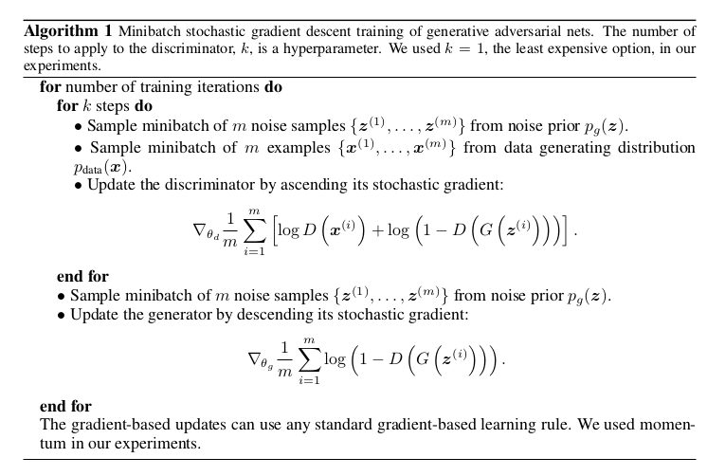
GAN: Methodology

Slide 15
GAN: Example
Consider an input space with 2x2 pixels, and 4 shade-levels of black for every pixel - 0, 0.25, 0.5, 1.
Now assume, we want to capture the model which has only those 4-pixel images which have darker spots on the top-left and bottom-right pixels. Ones that look like these, or ‘left-diagonals’:
source: Luis Serrano
1
0.75
0
0.5
1
0.75
0.75
0.25
0.25
0
0
1
0
0.75
0
0.75

Slide 16
GAN: Example
Diagonals
Non-Diagonals
1
0
0.25
1
0
1
0.5
0.75
1*1 + 0*(-1) + 0*(-1) + 1*1 = 2
0.25*1 + 1*(-1) + 0.5*(-1) + 0.75*1 = -0.5

Slide 17
GAN: Example
Diagonals
Non-Diagonals
1
0
0.25
1
0
1
0.5
0.75
1*1 + 0*(-1) + 0*(-1) + 1*1 = 2
0.25*1 + 1*(-1) + 0.5*(-1) + 0.75*1 = -0.5
In other words, value > 1 implies a diagonal, and a value < 1 implies no diagonal

Slide 18
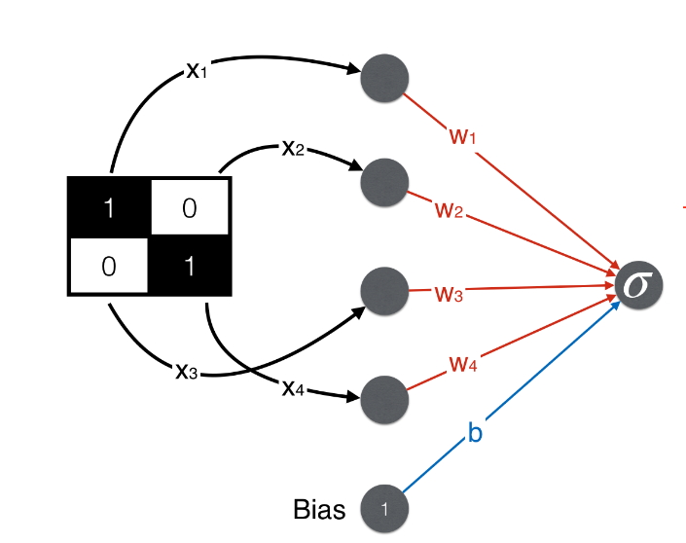
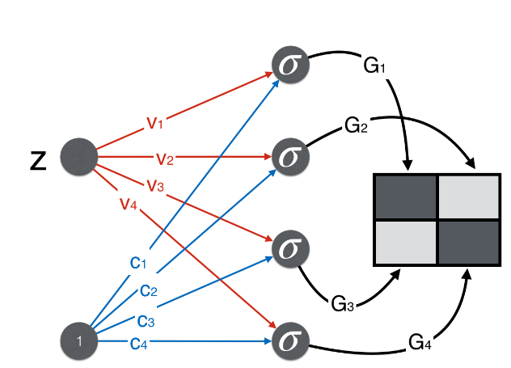
GAN: Example
For constructing the Discriminator:
For constructing the Generator:

Slide 19
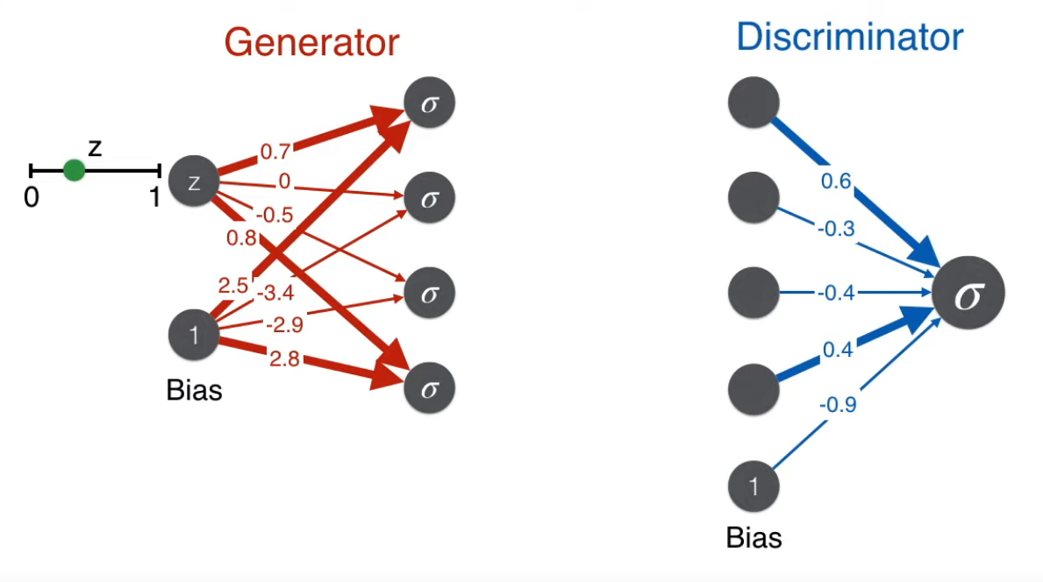
GAN: Example

Slide 20
Hands-On Demo 1 DC-GAN - PyTorch:
DC-GAN
Deep-Convolutional Generative Adverserial Network
Based on the paper by Radford et. al. “Unsupervised Representation Learning With Deep Convolutional Generative Adversarial Networks.”
Basically an extension of GAN with carefully designed, additional convolutional layers.
These convolutional layers help capture additional correlations and inter-dependencies within the data distribution.
Therefore, DC-GANs are very useful when dealing with image or video data.

Slide 21
Hands-On Demo 2 Nvidia StyleGAN https://github.com/NVlabs/stylegan

Slide 22
GAN: Research at CSU
GANs to model IoT network characteristics and improve intrusion-detection.
GANs for detecting fake profiles, or forged biometric data

Slide 23
End of Presentation

